Slide 1

Introduction to MEAN
Full Stack development

Slide 2
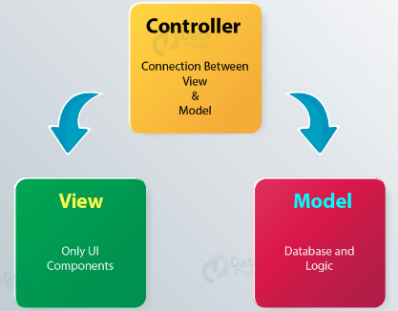
Three tier web development architecture
Presentation Layer
HTML5, JavaScript & CSS
Application Layer
Java, .Net, C#, Python, C++
Web applications are built in a three-tier architecture.
It has three important layers
PRESENTATION, LOGIC & DATA.
Modern web development has gone a step ahead
PRESENTATION – Client logic and UI.
The Paradigm of implementing this model is MVC architectural pattern.
The VIEW handles the visual part of user interaction.
The MODEL handles the data manipulation, responding to request of information.
The CONTROLLER responds to system and user events, Commanding the MODEL & VIEW to change appropriately.
Data Layer
MySQL, Oracle, MongoDB
Controller
Model
View

Slide 3
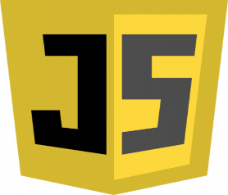

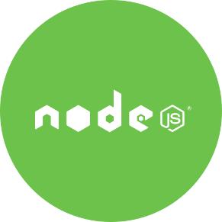
Evolution of JavaScript
JavaScript was created by “Brendan Eich”.
It is interpreted programming language.
Netscape Navigator web browser which was known as “LiveScript”.
Netscape altered the name to “JavaScript” to take the advantage of “Java”
Internet Explorer 3.0 also started using “JavaScript-Clone” – “Jscript”
Developers started creating libraries and tools for advanced web applications.
Real revolution began in 2008, Google launched Chrome, along with its fast JIT-compiling V8 JavaScript engine.
This source code allowed developers to start reimagining JavaScript outside of the browser.
This led to the product known as “Node.js”.

Slide 4

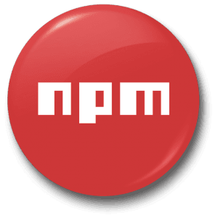
Evolution of JavaScript
Node.js is open-source server side runtime environment built on Chrome's V8 JavaScript engine - Ryan Dahl.
It provides an event driven, non-blocking (asynchronous) I/O and cross-platform runtime environment.
Advantages of Non-Blocking units of code
Allowed better utilization of system resources
Create responsive applications.
Node’s module system enabled developers to freely extend the platform using third-party module.
Thus the era of Server-Side JavaScript began.
Node.js is generally known as “Node”, is a powerful tool that can run JavaScript applications on both the server side as well as the client side.
Its build for highly scalable server-side application using JavaScript.
Prerequisites:
HTML, JavaScript & Web Application.

Slide 5



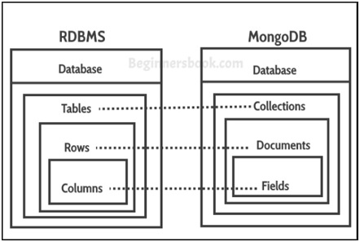
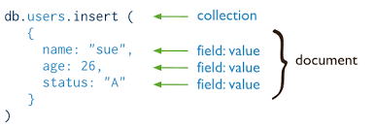

Evolution of JavaScript
Dwight Merriman, Kevin P. Ryan & Eliot Horowitz were building PAAS architecture based entirely on Open Source Components.
They were unable to find the existing database platform that met their “principles” for a cloud architecture.
They were able to build Document Oriented Database system (V8 based) – MongoDB
MongoDB was a scalable NoSQL database that used a JSON-like data model.
MongoDB gained a lot of traction
When dealing with complex data.
Providing the RDBMS features – Advanced queries and easy scaling.
JavaScript broke another boundary.

Slide 6
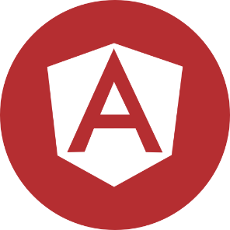


Evolution of JavaScript
In 2009 Misko Hevery & Adam Abrons were building JSON storage service with common JavaScript Libraries.
The nature of their web application raised the need of structured framework.
They started developing their frontend framework and open sourced the project - AngularJS.
The idea was to bridge the gap between JavaScript and HTML. – Single Page Application
The result was a rich framework comprising of:
Two-way data binding
cross-component dependency injection
MVC-based components
This supported advanced development paradigms – TDD.
“ Open source collaboration tools, along with the devoted involvement of these talented engineers, created one of the richest communities in the world - allowed the development of three-tier web applications using JavaScript. ”
MEAN stack is just a single example of this idea

Slide 7

Introducing MEAN
MEAN is an abbreviation for MongoDB, Express, AngularJS, and Node.js.
The concept behind it is to use only JavaScript - driven solutions.
Advantages:
A single language is used throughout the application.
All the parts of the application can support and often enforce the use of the MVC architecture.
Serialization and deserialization of data structures is no longer needed because data marshaling is done using JSON object structured framework.
Few concerns:
How do you connect all the components together?
Node.js has a huge ecosystem of modules, so which modules should you use?
JavaScript is paradigm agnostic, so how can you maintain the MVC application structure?
JSON is a schema-less data structure, so how and when should you model your data?
How do you handle user authentication?
How should you use the Node.js non-blocking architecture to support real-time interactions?
How can you test your MEAN application code base?
What kind of JavaScript development tools can you use to expedite your MEAN application development process?

Slide 8
Installing mongo DB
There is a official MongoDB website which provides easiest way to install on Linux, Mac OS X & Windows operating system for the right architecture (32-bit or 64-bit).
MongoDB can be downloaded from the mentioned url - https://www.mongodb.com/download-center.
Installing MongoDB on Windows:
MongoDB installation can be done in two ways:
Download the archived binaries (zip) file
Extract the archived package, locate the mongod binary in the “bin” directory.
mongod process runs the main MongoDB server process which can be Standalone or Single Node Server
mongod process will store the data under default directory - /data/db.
The default listening port will be 27017.
To run mongod manually, open the command prompt navigate to the extracted directory of MongoDB packages.
Run the “mongod.exe” from the “bin” directory
Download the suitable “MSI” installer.

Slide 9
Installing mongo DB
Installing MongoDB on Mac OS X and Linux:
MongoDB installation using archived binaries:
Download the archived files (.tgz)
Extract the files by using the command – tar –zxvf <archived_filename>.
Rename the extracted directory to simple name – mv mongodb-osx-x86_64-2.6.4 mongodb.
Set the default directory location to store the data - mkdir -p /data/db.
Set the directory permission to access - chown -R $USER /data/db.
Navigate to the “bin” directory of the extracted directory and execute the command - mongod
MongoDB installation using package Manager:
Download the MongoDB instance using the package manager, which will automatically install the dependencies.
This is applicable for – RedHat, Debian, Ubuntu & Homebrew packages
Start using Mongo Shell or any GUI to access MongoDB - RoboMongo.
Welcome to Document Oriented Database!!!

Slide 10
Installing NODe.js
Installing Node.js:
On Windows:
Download the Node.js installer for windows platform for the right architecture - https://nodejs.org/en/
After downloading the installer execute the installer with “Next” setup steps until the installation is successful.
Linux:
Download the Node.js archived package for linux platform for the right architecture - https://nodejs.org/en/
Extract the archived package - tar -zxf <node_package_version>.tar.gz
cd <node_package_version>
./configure && make && sudo make install
Or Use the Package Manager and install Node.js - sudo apt-get install nodejs
Mac OS X:
Download the Node.js installer (.pkg) for Mac OS X platform for the right architecture - https://nodejs.org/en/
After downloading the installer execute the installer with “Continue” setup steps until the installation is successful.

Slide 11
Introducing NPM
Node.js is a platform with minimum features and API’s
To Achieve more complex functionalities, it uses module system to extend the platform.
NPM (Node Package Manager)– Is the recommended way to install, update & remove Node.js modules
Features of NPM:
A registry of packages to browse, download, and install third-party modules.
A CLI tool to manage local and global packages.
NPM is a robust package manager, which keeps a centralized registry for public modules
To browse the available public libraries - https://www.npmjs.com/
Installation process of NPM has two modes:
Local – Install the third party packages in a local “node_modules” directory of the project, which will not affect the system.
npm install <package_name> | npm install <package_name>@<version_number>
Global – Install the packages that Node.js needs globally (Grunt) – under “/usr/local/lib/node_modules” directory.
npm install –g <package_name>
Remove Package - npm uninstall <package_name>
Update Package – npm update <package_name>

Slide 12



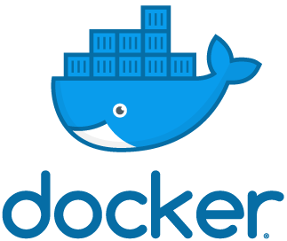

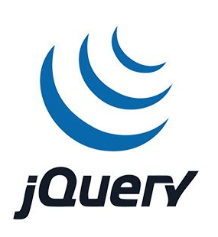

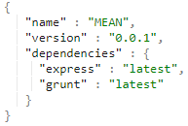
Managing dependencies
Installing single package is pretty nice, But the application development needs several packages.
There has to be a better way to install and manage these dependencies.
NPM provides the provision for the configuration file – “package.json”.
This file contains various properties of the application:
Metadata, Name, Version & Author.
Creating a “package.json” file:
Command - npm init
NPM will pose you few questions and then creates the package.json file.
Command to install – npm install
All the dependencies will be installed in “node_modules” directory.
Command to update – npm update
Updating the “package.json” file
npm install <package_name> --save

Slide 13
Thank you!

